Slide 1
Lecture 4.4 Third Degree Price discrimination

Slide 2
Third degree price discrimination
It is difficult to learn each individual consumer’s willingness to pay. It is more practical to divide consumers into a few groups according to observable characteristics.
e.g. age or gender
e.g. timing or location of purchase
Third degree price discrimination is the charging of a different price to different groups.
Separate the market into the appropriate number of groups. Then maximise profit as a single price monopolist in each of the separate sub-markets.

Slide 3
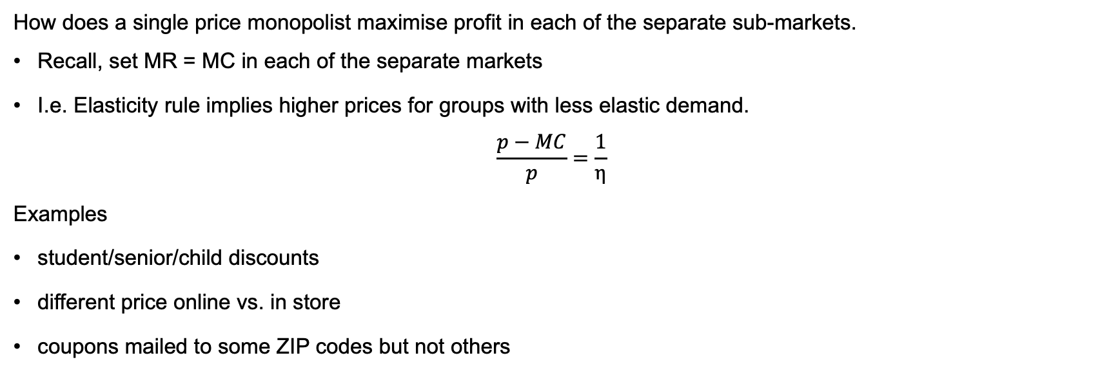
Third degree price discrimination
How does a single price monopolist maximise profit in each of the separate sub-markets.
Recall, set MR = MC in each of the separate markets
I.e. Elasticity rule implies higher prices for groups with less elastic demand.
$$\frac{p−MC}{p}=\frac{1}{η}$$
Examples
student/senior/child discounts
different price online vs. in store
coupons mailed to some ZIP codes but not others

Slide 4
Third degree price discrimination
Effects of third degree price discrimination based on market segmentation:
Profit must go up
Ambiguous effects on consumer surplus and total welfare.
Practical difficulties:
Identification of each consumer group’s demand
Arbitrage
Possible legal/PR issues (though price discrimination is not per se illegal)

